Slide 1
Employee Data Analysis using Excel
STUDENT NAME: RAMYA. H
REGISTER NO : 122204275
DEPARTMENT : BCOM ( CORPORATE SECRETARYSHIP)
COLLEGE : GOVT ARTS AND SCIENCE COLLEGE RK NAGAR
CHENNAI - 81
COLLEGE CODE : 1683

Slide 2
PROJECT TITLE
Employee Performance Analysis using Excel

Slide 3


AGENDA
Problem Statement
Project Overview
End Users
Our Solution and Proposition
Dataset Description
Modelling Approach
Results and Discussion
Conclusion
3/21/2024 Annual Review

Slide 4

Analysing individual and team performance helps identify top performers, areas where training is needed and how to better align employee efforts with organisational goal. Performance analysis helps organization pinpoint areas where they are excelling and areas that need improvement.
Program Statemement
.

Slide 5

PROJECT OVERVIEW
Employee performance analyzing means analyzing the performance of the employee by considering various factors like Gender, Performance Score, Rating and their achievements. It also identify the trends and patterns of different categories of employee performance

Slide 6

WHO ARE THE END USERS? 1. Executive Leadership 2. Managers and Department heads 3. HR Team 4. Financial Analysts and accountants 5. Project Managers 6. Sales and Marketing Teams 7. IT and Data Analysts 8. Quality Assurance Teams 9. Operations Teams 10. External stakeholders

Slide 7

OUR SOLUTION AND ITS VALUE PROPOSITION Conditional formatting - Missing Filter - Remove Formula – Performance Pivot – Summary Graph – Data Visualization

Slide 8
Dataset Description Employee = Edunet 27 - Features 9 - Features Employee id - Number Name - Text Employee type - Text Performance level - Text Gender - Male, Female Employee Rating – Number

Slide 9

THE "WOW" IN OUR SOLUTION Performance level = IFS ( Z8>=5,”VERY HIGH”,Z8>4,”HIGH“,Z8>=3,”MED”,TRUE,”LOW”)
3/21/2024 Annual Review
9

Slide 10
MODELLING
Data Collection
Download the data in the edunet website
And ready to work project
Feature collection
Identify the employee id
And identify the priority
Group similar features together
Data Cleaning
Identify the missing value
And filter the missing values
10

Slide 11
Performance level 1) Calculating the performance level 2) find the performance level with the help of rating of the employee Summary 1) Create the pivort table 2) The features are used in pivot chart 3) Row – Business Unit 4) Column – Performance level 5) Values – First Name 6) Filter – Gender Code, Department Type

Slide 12
Visualisation 1) The features are used in pivot chart 3) Row – Business Unit 4) Column – Performance level 5) Values – First Name 6) Filter – Gender Code, Department Type

Slide 13
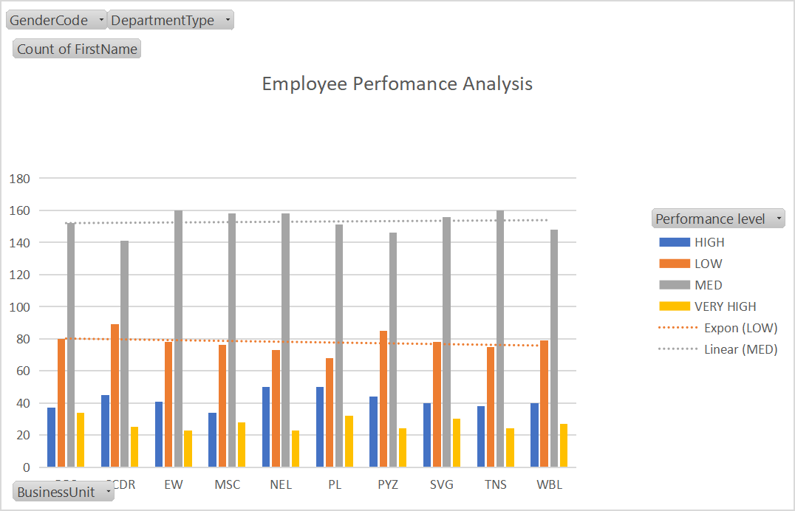
RESULTS
13

Slide 14
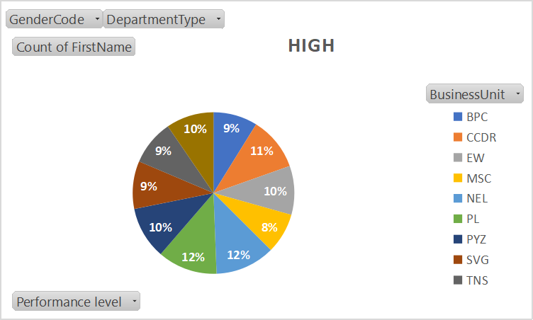
Disscusion
.

Slide 15
Conclusion Performance analysis is a crucial process for organizations striving to optimize their operations improve efficiency and achieve strategic goals. The insights gained from performance analysis enable informed decision-making allowing leaders to allocate resources effectively refine processes, and set realistic, data-driven objectives Performance analysis is not just about assessing past and present performance; it’s about building a foundation for future success. By continuously monitoring and analyzing performance, organization can ensure they are on the right path toward sustained improvement and long term achievement.

